Slide 1
Modern, Buildable Projects with IBM i Project Explorer and Bob
Edmund Reinhardt
Product Architect - IBM i Application Development
edmund.reinhardt@ca.ibm.com
Sanjula Ganepola
Software Developer
Sanjula.Ganepola@ibm.com

Slide 2
Agenda
Challenges with Building on IBM I
How do IBM i Projects and Bob overcome this?
Ins and Outs of IBM i Project Explorer
Demo

Slide 3
Challenges with Building on IBM i

Slide 4




Building on IBM i is hard…
SRC-PF
10 char names
Fixed record length
Not accessible to open ecosystem, including Git and Make
Source of the same type stored in QxxxSRC to avoid name conflicts (member type does not disambiguate)
Libraries
Only 2 level hierarchy to organize, with only short 10 char names
Source control
None (sequence number dates)
Home grown
Proprietary IBM i systems
Cost
Smaller market = less investment
Build system
Individual CRTXXXMOD + CRTPGM
CL Scripts
A couple of vendors have dependency-based build

Slide 5
How do IBM i Projects and Bob overcome this?

Slide 6
Let's use a different (but similar) file system
MYPROJECT
QRPGLESRC
PROGRAMA.RPGLE
PROGRAMB.RPGLE
PROGRAMC.RPGLE
QSQLSRC
CUSTOMERS.SQL
INVENTORY.SQL
QCLLESRC
START.CLLE
QCMDSRC
STARTJOB.CMD
/my-project
/.git
qrpglesrc
programa.rpgle
programb.rpgle
programc.rpgle
qsqlsrc
customers.sql
inventory.sql
qcllesrc
start.clle
qcmdsrc
Startjob.cmd
No more character name restrictions
Now usable with Git and Make
Flexible directory structure
QSYS.LIB Library
IFS/Local File System

Slide 7






Unlock source control with Git
Distributed Development
Version Control and Git Workflow
master
Remote Git Repo (GitHub, GitLab, Azure, BitBucket, etc.)
develop
feature A
feature B
Developer A
Developer B

Slide 8


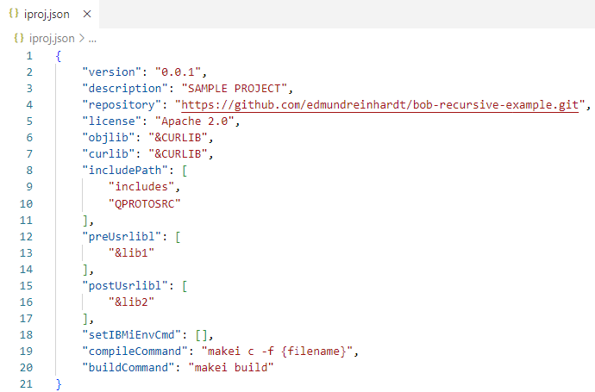
Projects that self-describe how to build themselves!?
my-project
.evfevent
file.evfevent
source.evfevent
.logs
Project Information
joblog.json
file.splf
Standardized metadata format with variables (&…)
source.splf
includes
constants.rpgleinc
QRPGLESRC
Configure library list
.ibmi.json
Rules.mk
source.rpgle
Set build/compile command
QDDSSRC
Rules.mk
file.pf
Configure build/compile environment
.env
.gitignore
.ibmi.json
iproj.json in project root
iproj.json
Rules.mk

Slide 9
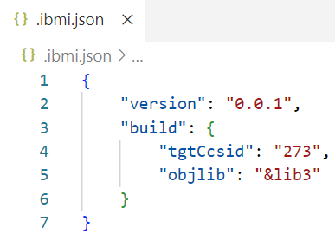
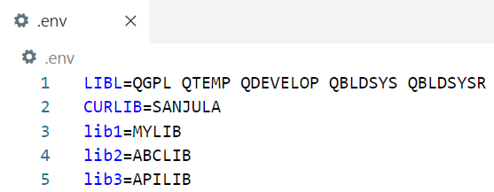
Projects that self-describe how to build themselves!?
my-project
.evfevent
file.evfevent
Target object library for directory
source.evfevent
.logs
joblog.json
file.splf
source.splf
EBCDIC encoding for compiler
includes
constants.rpgleinc
QRPGLESRC
.ibmi.json in subdirectories
.ibmi.json
Rules.mk
source.rpgle
QDDSSRC
Rules.mk
Custom variable values so that each developer can customize build
file.pf
.env
.gitignore
.ibmi.json
iproj.json
.env in project root
Rules.mk

Slide 10
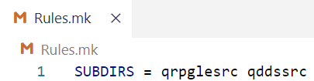
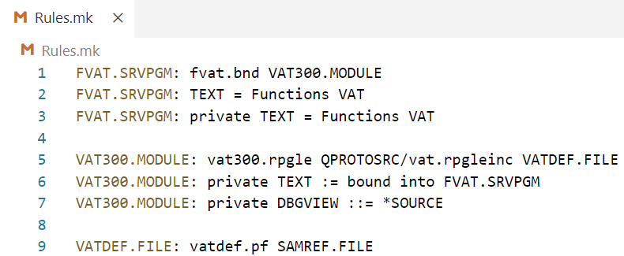
Projects that self-describe how to build themselves!?
my-project
.evfevent
file.evfevent
source.evfevent
.logs
Declare subdirectories to be built
joblog.json
file.splf
source.splf
Rules.mk in project root
includes
constants.rpgleinc
QRPGLESRC
.ibmi.json
Rules.mk
source.rpgle
QDDSSRC
Rules.mk
Make style list of objects to be built and from what source files
file.pf
.env
.gitignore
.ibmi.json
iproj.json
Rules.mk in subdirectories
Rules.mk

Slide 11
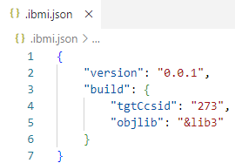
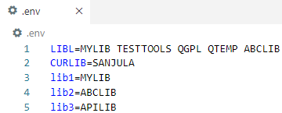
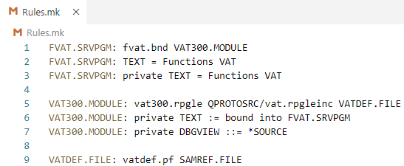
Projects that self-describe how to build themselves!?
my-project
.evfevent
Target object library for directory and EBCDIC encoding for compiler
file.evfevent
source.evfevent
.logs
joblog.json
file.splf
source.splf
.ibmi.json
includes
constants.rpgleinc
QRPGLESRC
.ibmi.json
Rules.mk
Variables so that each developer can customize build
source.rpgle
.env
QDDSSRC
Rules.mk
file.pf
.env
.gitignore
iproj.json
.ibmi.json
iproj.json
Rules.mk
Make style list of objects to be built and from what source files
Rules.mk

Slide 12
Build and Compile Process
Initialization and Migration
Command | Description
makei init | Create iproj.json
makei cvtsrcpf | Convert QSYS members to Unicode IFS stream files
Building
Command | Description
makei build | Build the entire project
makei b –t <object> | Build target object
makei b –d <directory> | Build all objects in the specified directory (based on Rules.mk)
Compiling
Command | Description
makei compile -f <stream file> | Compile target object of specified stream file
makei compile –files file1: file2: … | Compile target objects of all specified stream files

Slide 13
Ins and Outs of IBM i Project Explorer

Slide 14
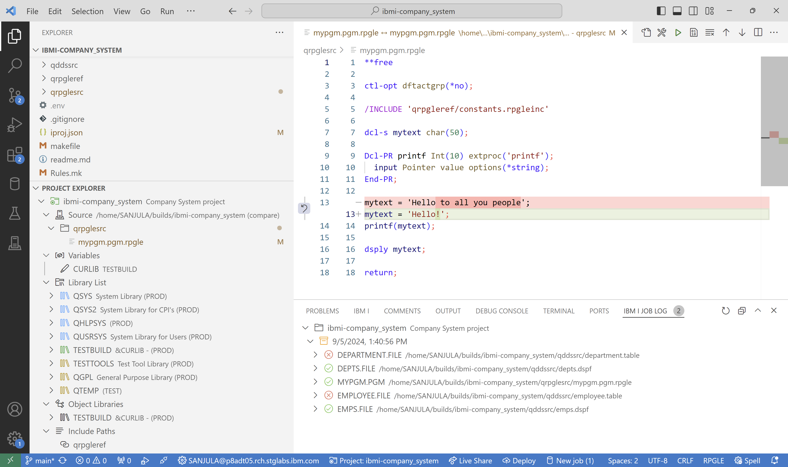
Overview
The ultimate tool for local development on IBM i!
Set variables
Build and Compile
Local source vs. IFS source
Manage library list
Modify include paths
View job logs

Slide 15
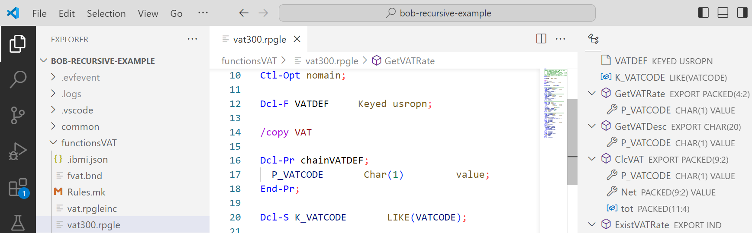
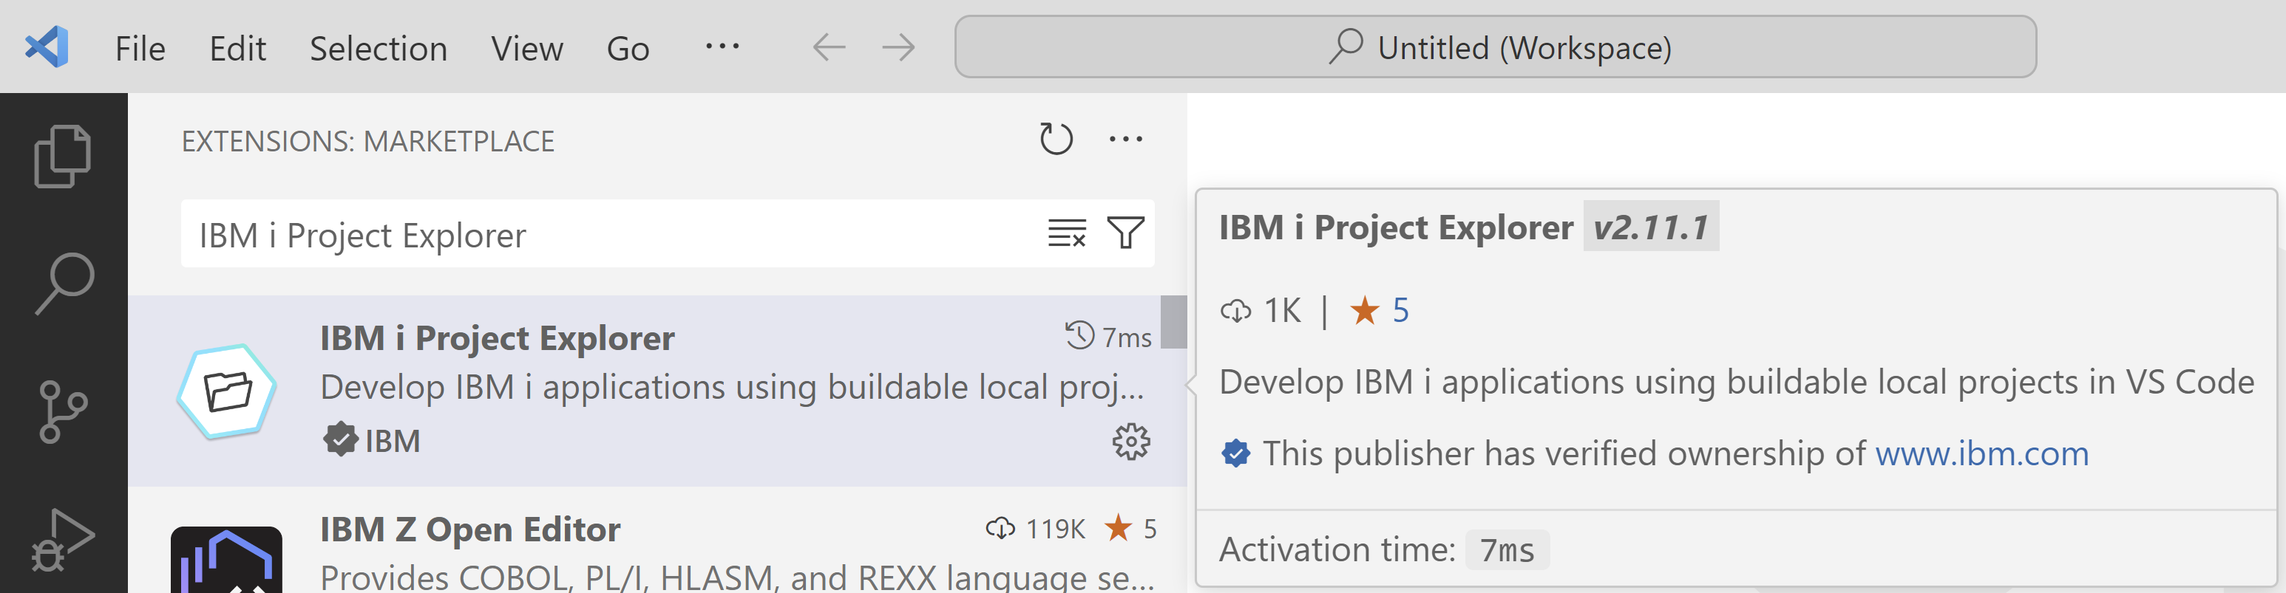
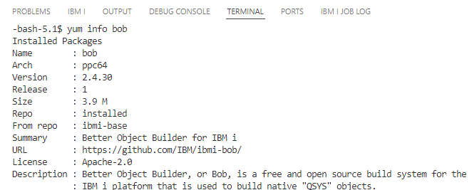
Installation
Download
Visual Studio Code
Download
IBM i Project Explorer
and Code for IBM i
Run
yum install bob
on IBM i

Slide 16
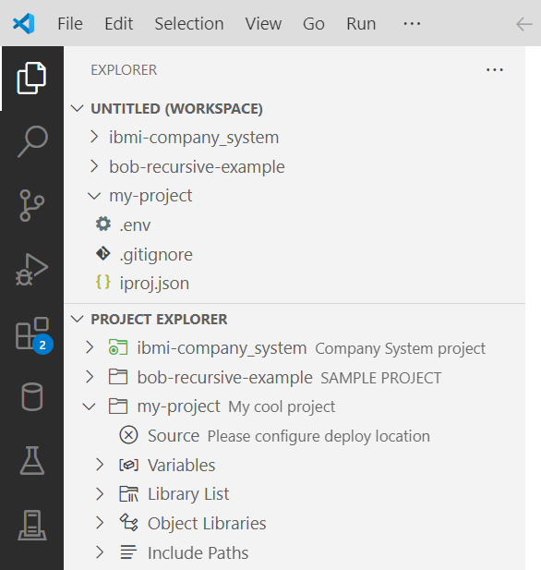
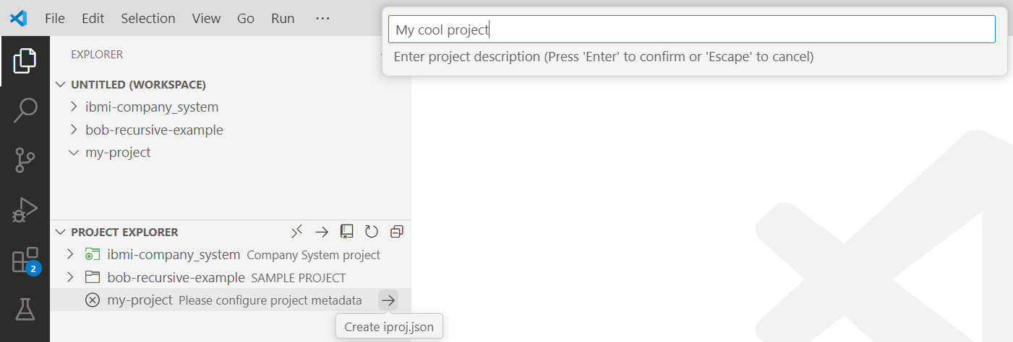
Create a New Project
Create and open a folder for your project
Create an iproj.json
Set the project description
Connect to an IBM i (using Code for IBM i)

Slide 17
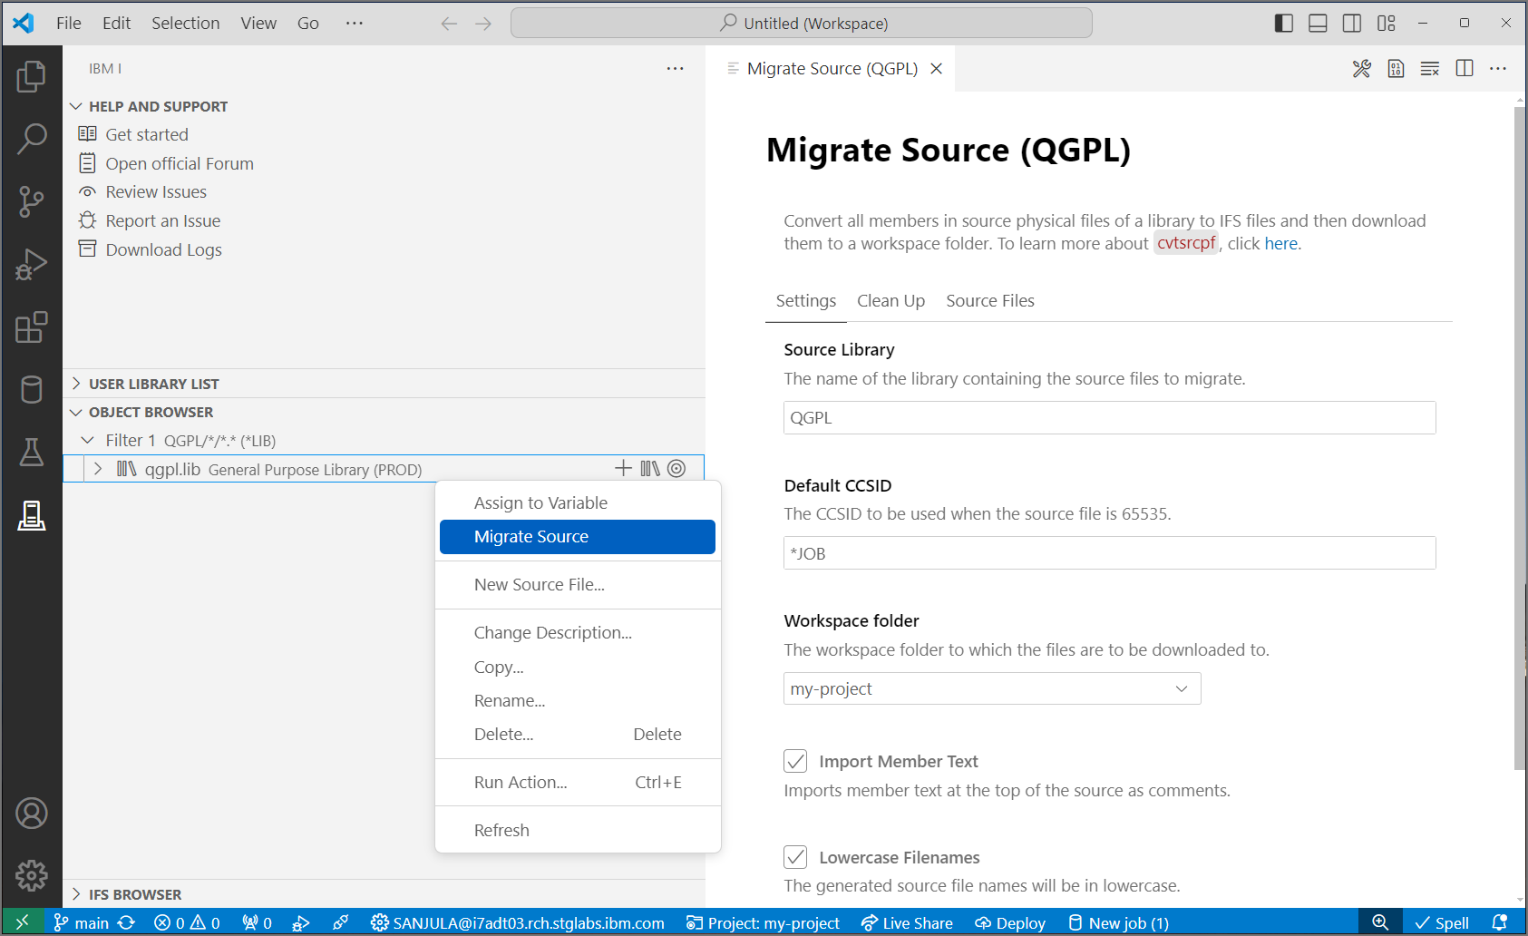


Migrate Source from QSYS
QSYS members in source physical files
↓
Properly encoded, terminated, and named source files in an IFS directory
↓
Download to local project
↓
Rename extensions
↓
Convert includes/copy directives to Unix style paths
CVTSRCPF from BOB
Source Orbit

Slide 18

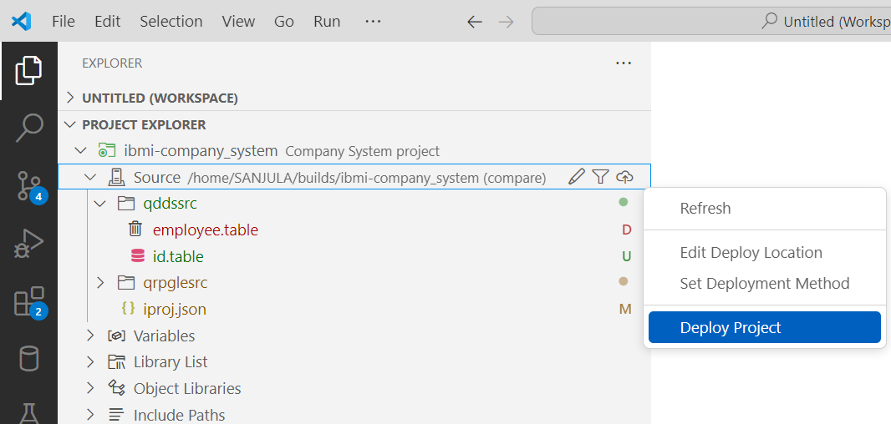
Source and Deployment
Set deploy location
Where source gets uploaded to
Typically set one
Each developer gets a unique location
Each repository gets a unique location
Set deployment method
Compare (typically the safest)
Changes
Working Changes
Staged Changes
All
Deploy project
Moves files to deploy location based on deployment method
Deploy
Build
Local Project
IBM i Directory
Target Library

Slide 19
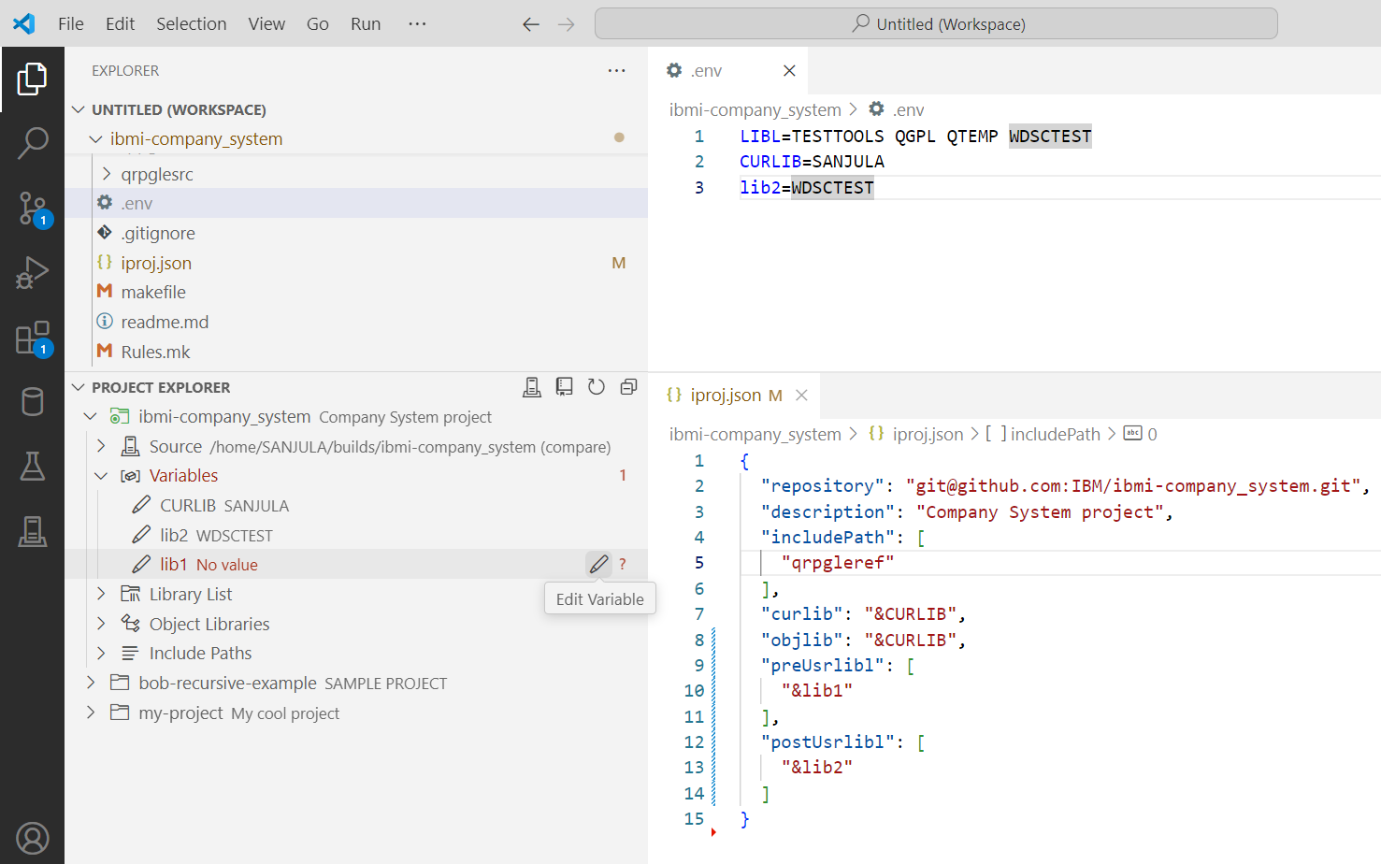
Work with Variables
View and set variables (for libraries, include paths, or build/compile commands)
Browse for libraries and assign values to variables
Configure hardcoded values as variables
Do not push .env file to Git!

Slide 20
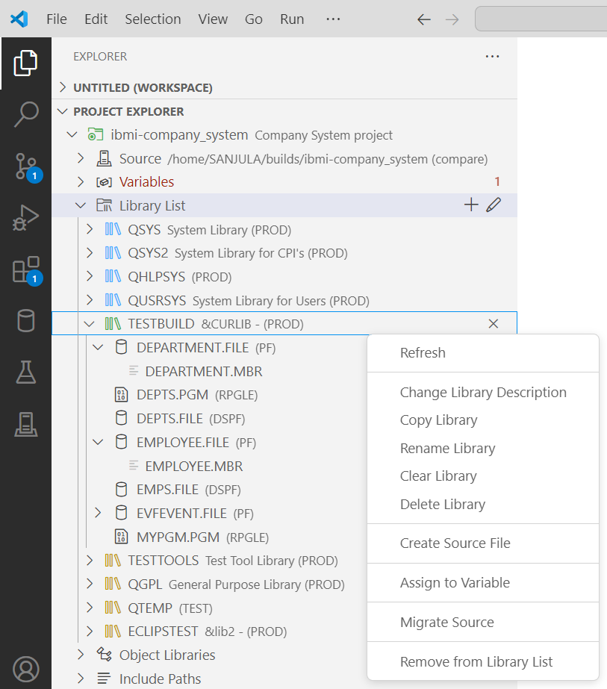
Manage the Library List
Add to beginning/end of library list (preUsrlibl and postUsrlibl) and set current library (curlib in iproj.json)
Reorder library list
Browse objects and members
Manage libraries, objects, and members

Slide 21
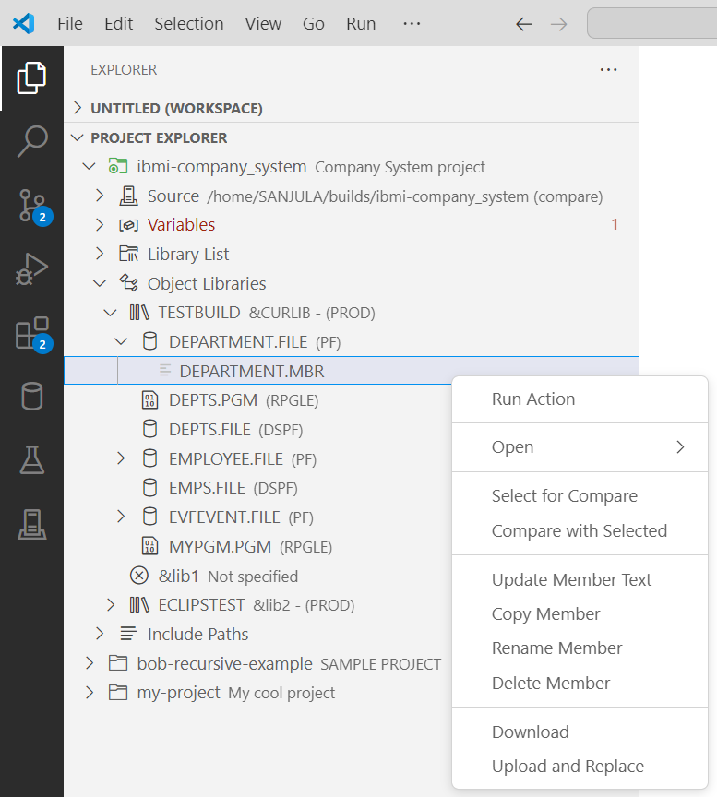
Browse Object Libraries
Another place to manage libraries in iproj.json (curlib, objlib, preUsrlibl, postUsrLibl)
Manage libraries, objects, and members

Slide 22
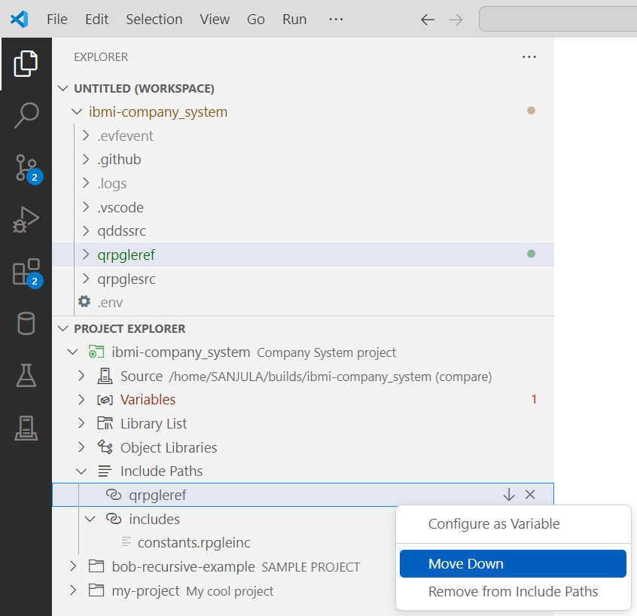
Manage Include Paths
Add, remove, and reorder include paths
Visualize if includes resolve locally or to remote IFS

Slide 23
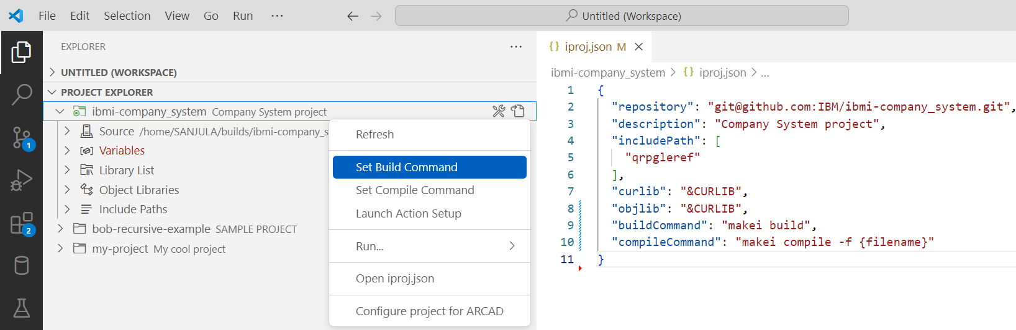
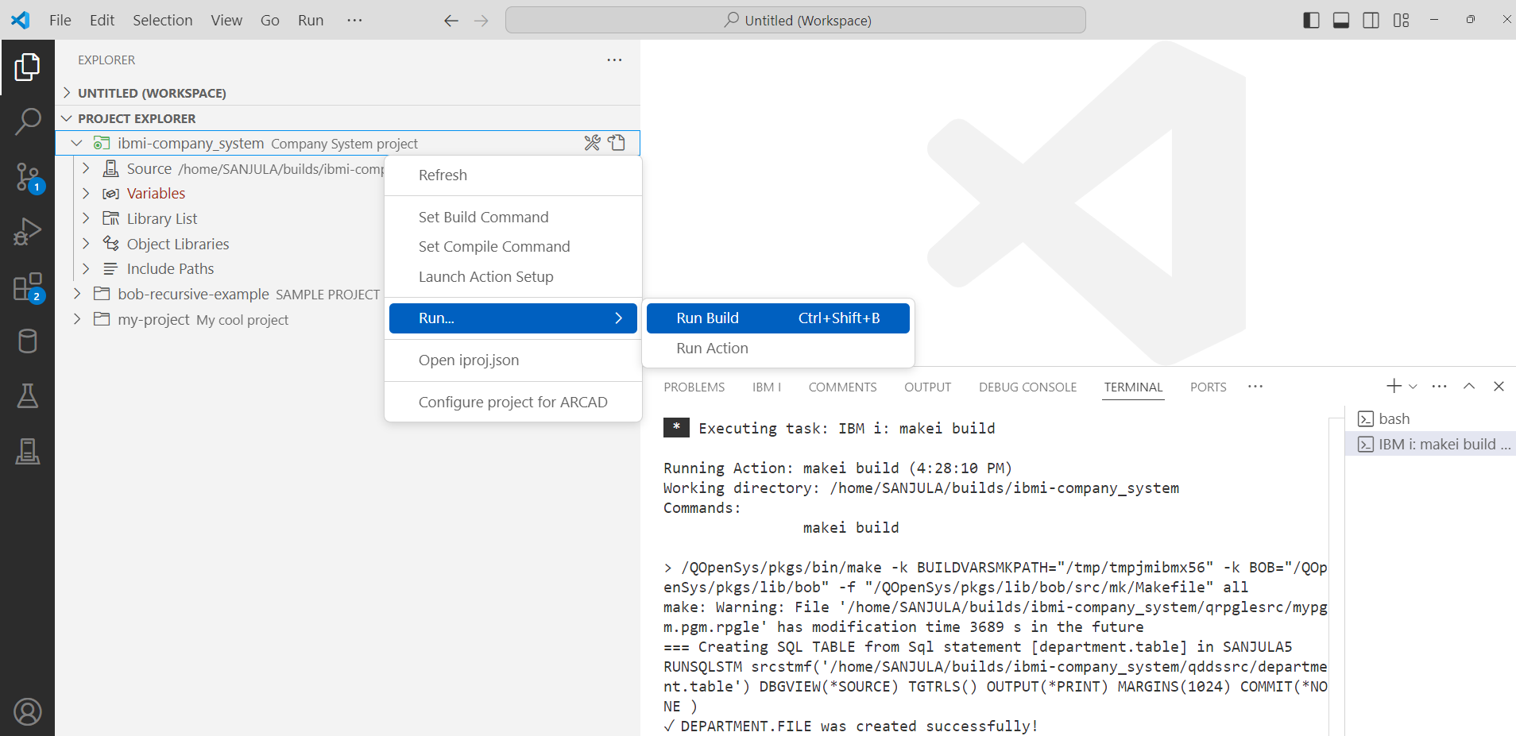
Build and Compile
Deploy
↓
Run build or compile command
↓
Download logs and evfevent files
Building
Set build command
Run Build
Compiling
Set compile command
Run compile
On active editor
On file or directory in File Explorer
On file or directory in Source

Slide 24
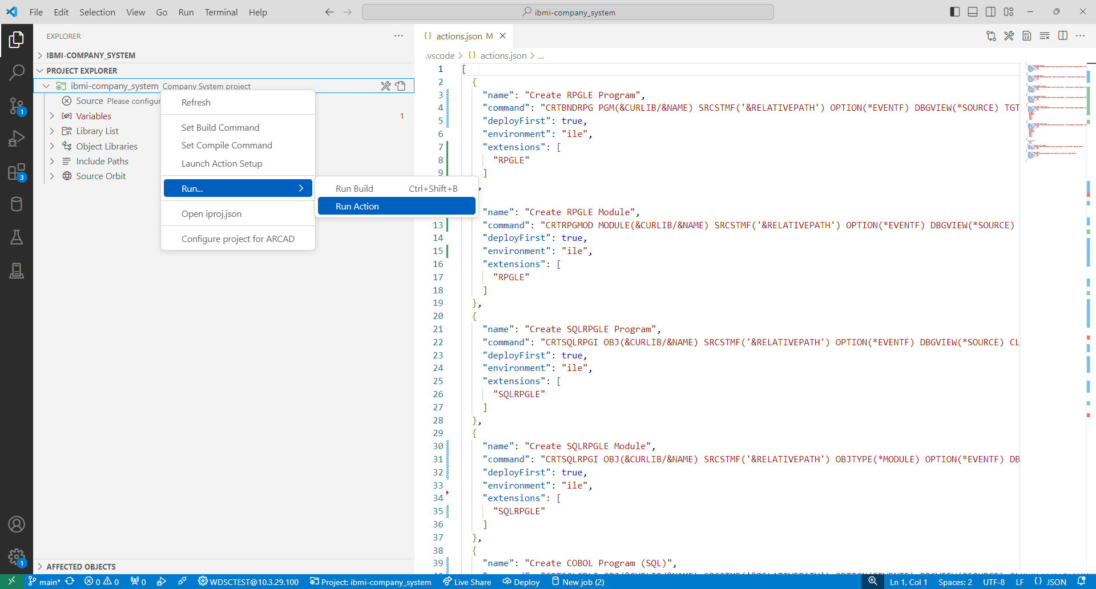
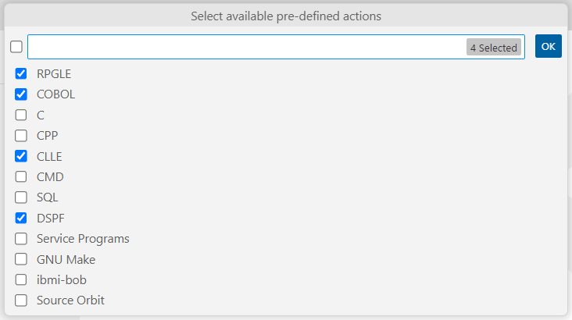
Run Actions
Run Code for IBM i’s custom workspace actions to have more control of the command which is executed

Slide 25
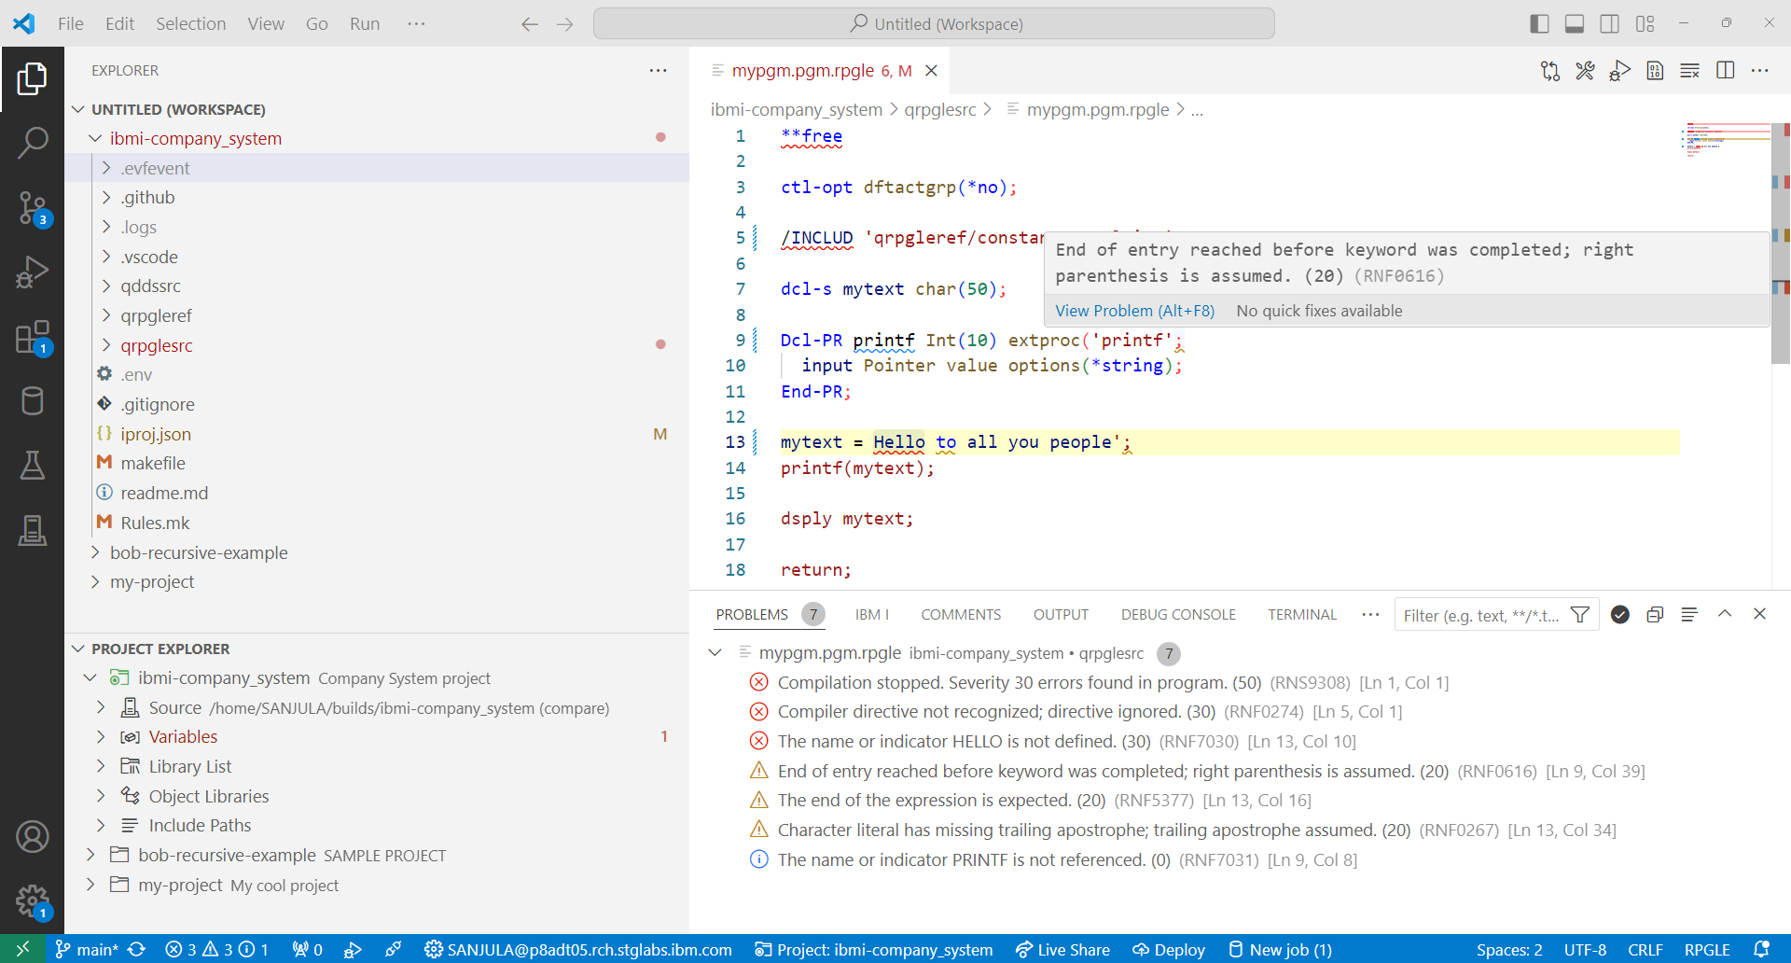
View Diagnostics
Evfevent file diagnostics are dumped in .evfevent directory after a build or compile
Visualize diagnostics in the Problems view
Diagnostics are also rendered inline in the source file

Slide 26
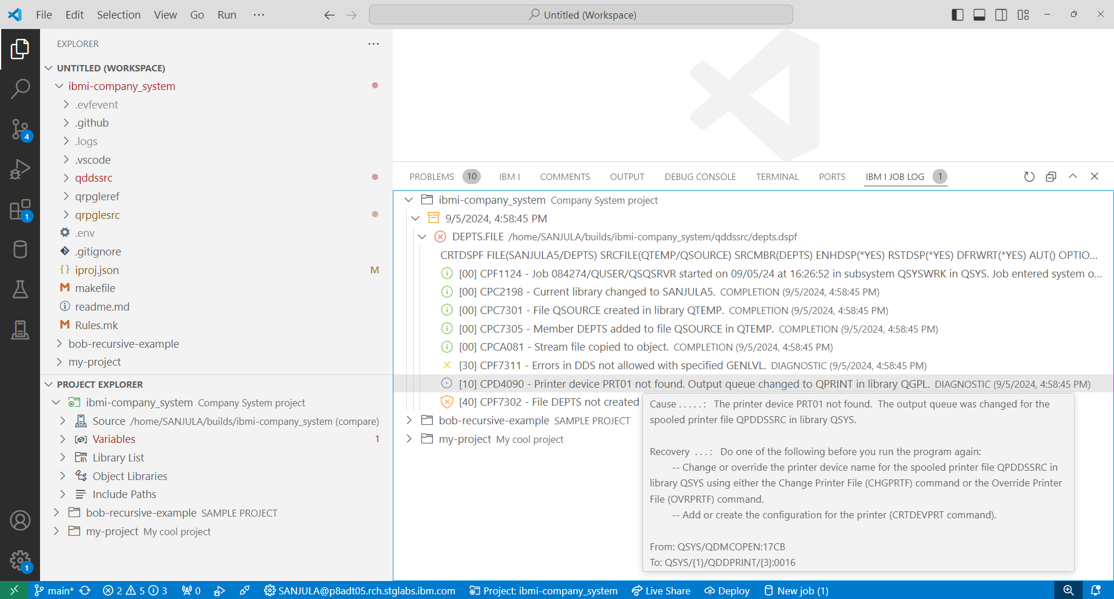
View Job Logs
Job log and spool files are dumped in .logs directory after a build or compile
Job log view is used to visualize and mangae these logs
Track up to 10 of the previous logs in memory
Organized by the ILE objects being built
Filter by failed objects or severity

Slide 27

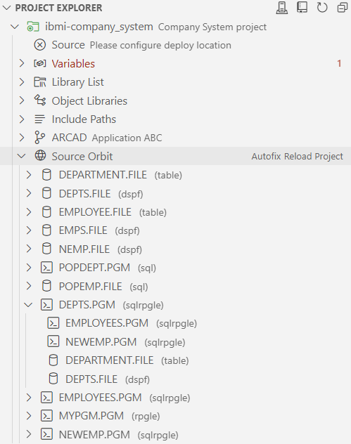
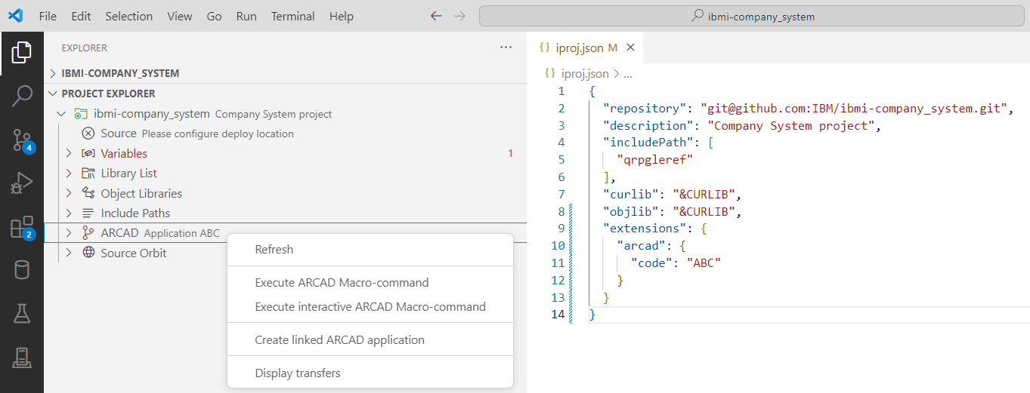
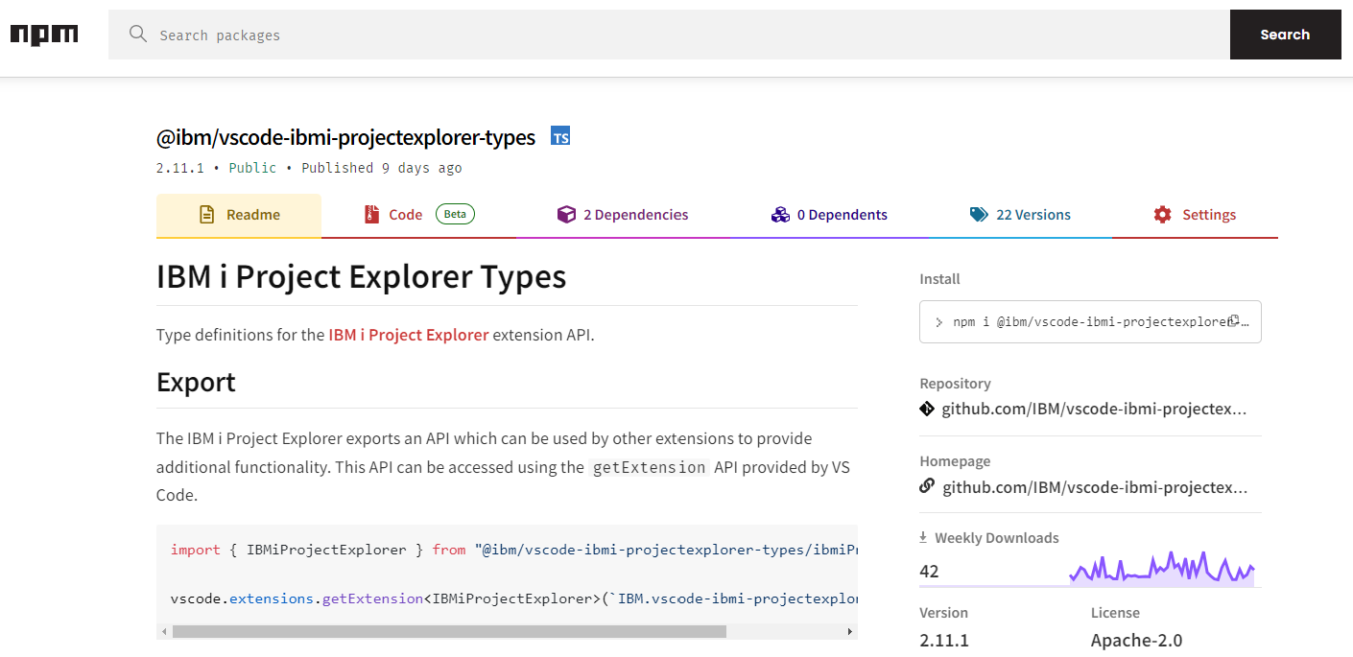
Integration
Source Orbit
ARCAD-Elias
What can you integrate with IBM i Project Explorer’s API?

Slide 28
Demo

Slide 30
Links
IBM i Project Explorer
VS Code Marketplace https://marketplace.visualstudio.com/items?itemName=IBM.vscode-ibmi-projectexplorer
Documentation https://ibm.github.io/vscode-ibmi-projectexplorer/#/
GitHub Repository https://github.com/IBM/vscode-ibmi-projectexplorer
API https://www.npmjs.com/package/@ibm/vscode-ibmi-projectexplorer-types
Bob
Documentation https://ibm.github.io/ibmi-bob/#/
GitHub Repository https://github.com/IBM/ibmi-bob
Code for IBM i
VS Code Marketplace https://marketplace.visualstudio.com/items?itemName=HalcyonTechLtd.code-for-ibmi
Documentation https://codefori.github.io/docs/#/
GitHub Repository https://github.com/codefori/vscode-ibmi
API https://www.npmjs.com/package/@halcyontech/vscode-ibmi-types

